Slide 1
How Data Scientists Will Save Humanity
Or… the best game of one potato, two potato, ever!
@garyshort

Slide 2

Introduction
Gary Short
Microsoft MVP C#
Freelance data scientist
Big Data / architect / engineer
HDInsight / Hadoop / Pig / Hive
Predictive Analytics
Machine Vision
Computational Linguistics
gary@duncodin.it
@garyshort
Image © @Blackmarble

Slide 3

Disaster? What Disaster?

Slide 4
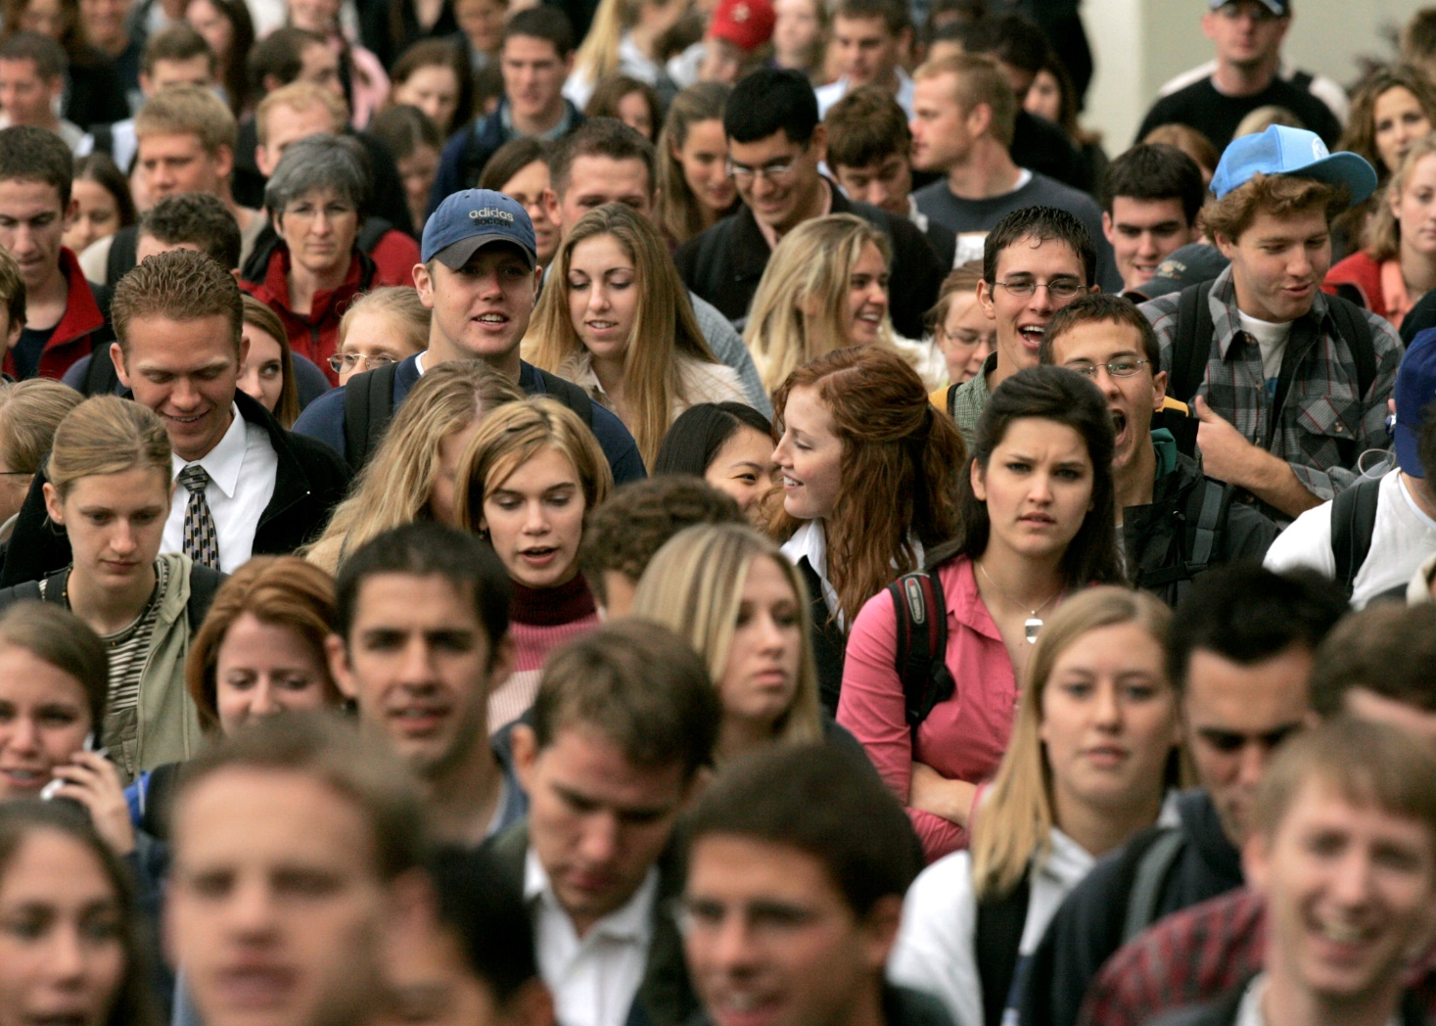
There Are a *LOT* of People on Planet

Slide 5

And it’s Only Getting Worse

Slide 6
Is Population Growth Exponential?

Slide 7
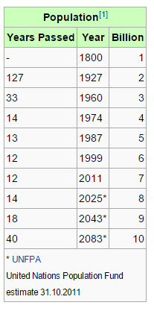
United Nations Says No

Slide 8
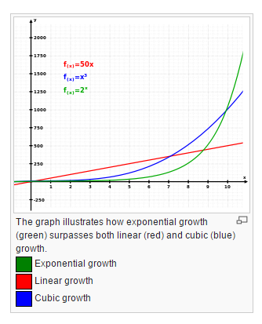
But Then…

Slide 9
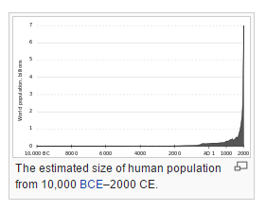
And…

Slide 10
Bottom Line is, There’s Lots of People, There’s Going to be More, And They’re All Going to Need Feeding.

Slide 11
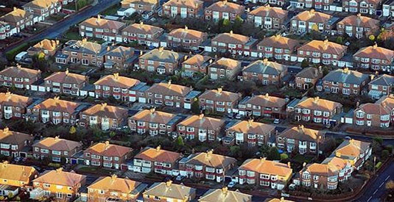
Not Only do They Need Fed, They Need Housed Too

Slide 12
And That’s an Issue, because…

Slide 13
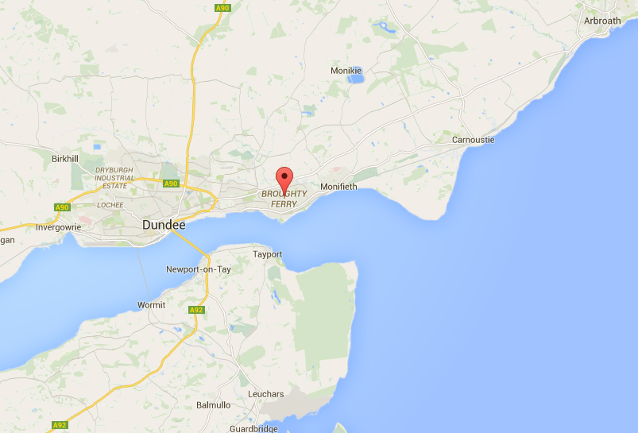

Slide 14
So at a Time When we Most Need Farming Production, We’re Selling of Prime Farmland
Yes, we really are that dumb. –Ed.

Slide 15
Clearly, we Need to Maximise Crop Yields

Slide 16
Step 1 - Preparing The Ground

Slide 17
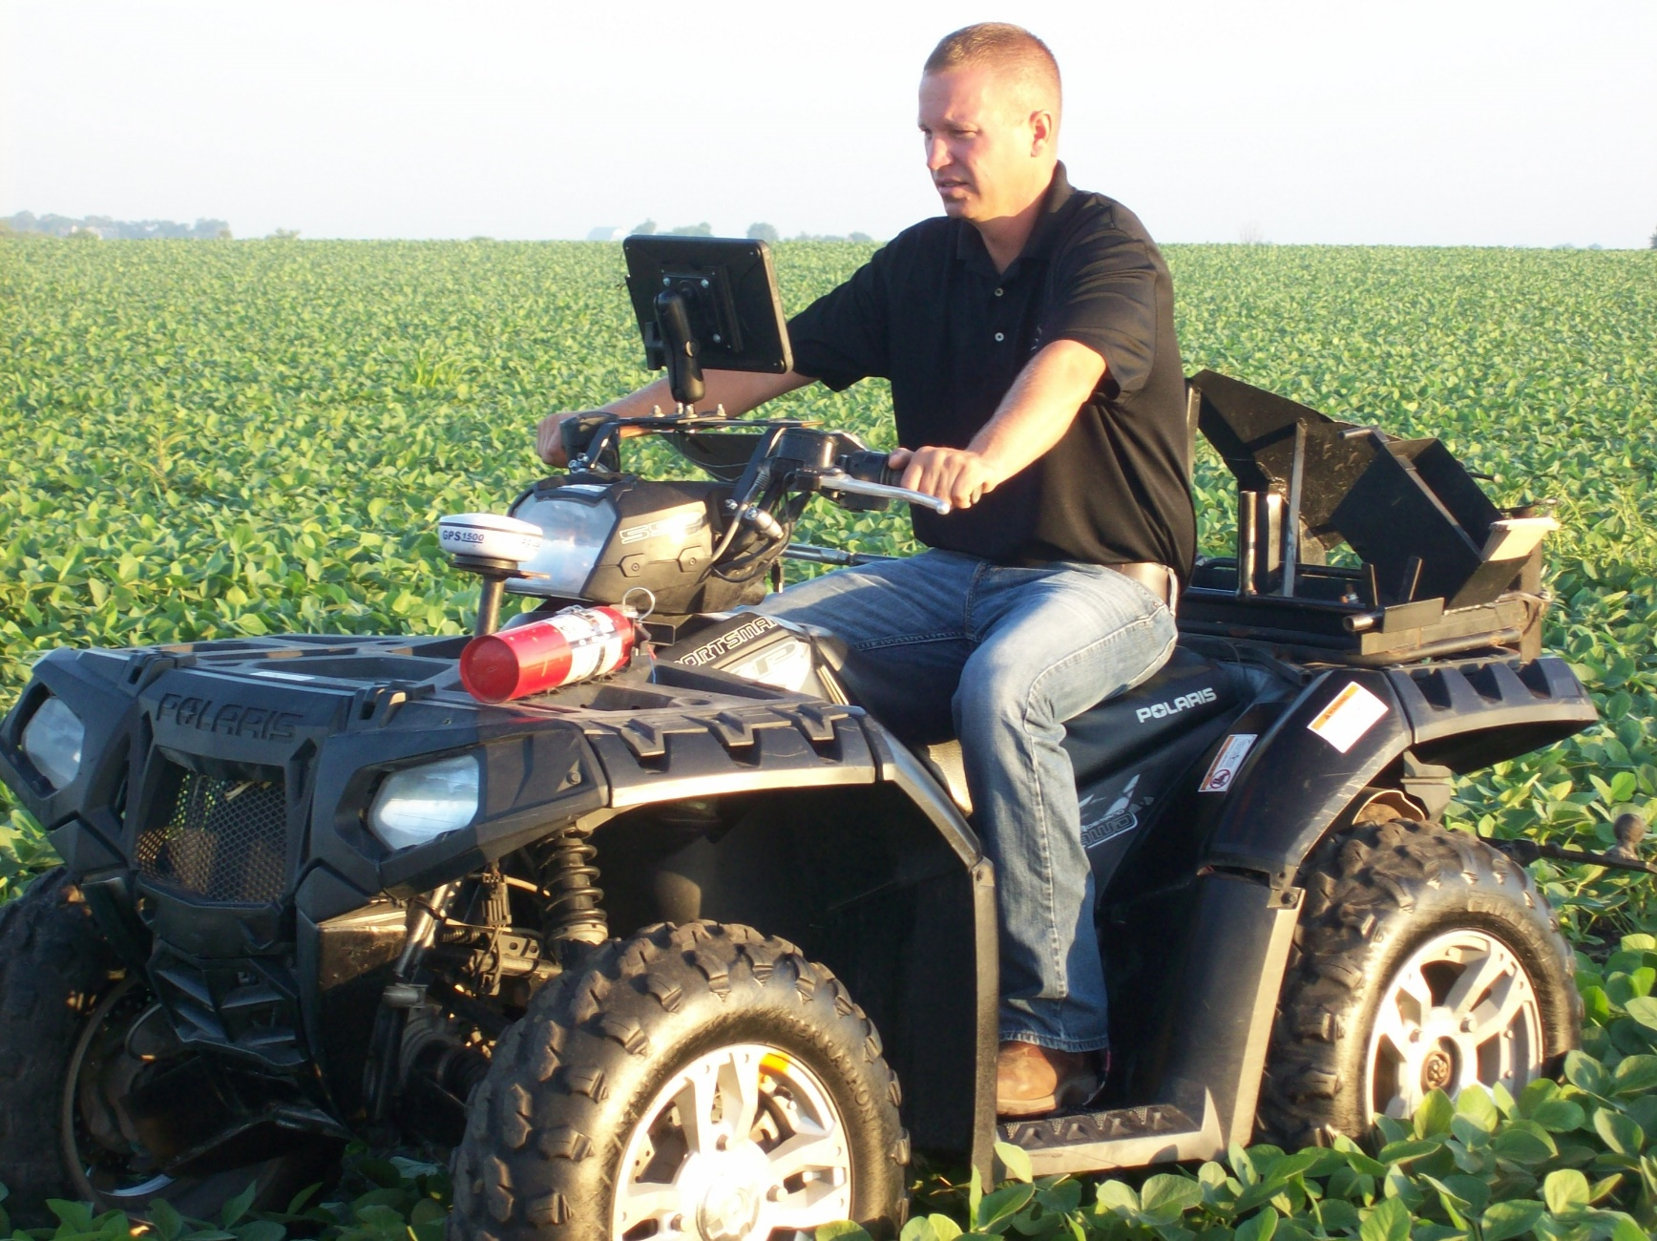
An Agronomist Will Sample The Soil

Slide 18
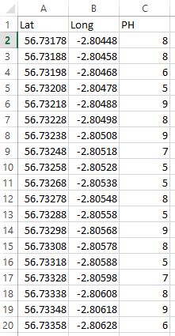
This Gives us Point Data

Slide 19
We Need to Interpolate That For The Full 50m X 50m Grid

Slide 20
Talk About Kriging Here…
Yeah, but don’t scare the punters. –Ed. ☺

Slide 21
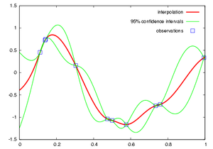

Slide 22
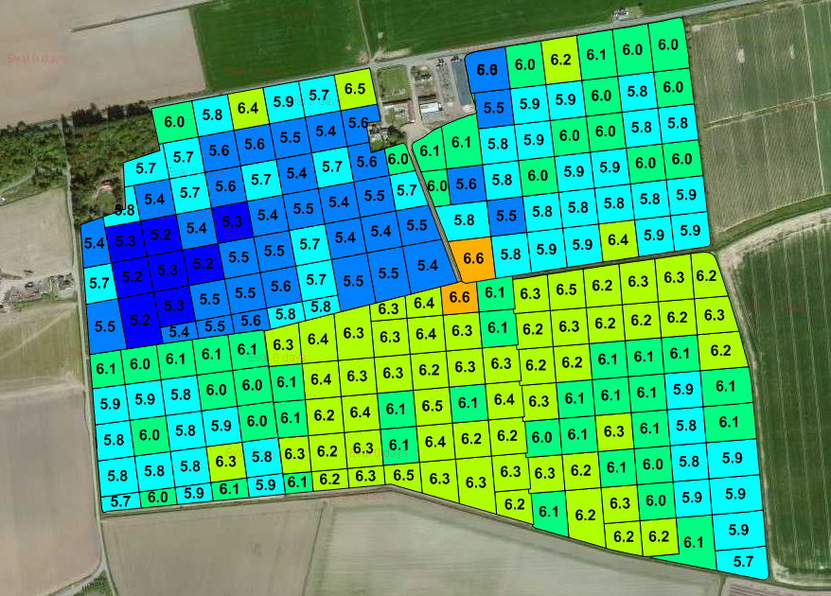
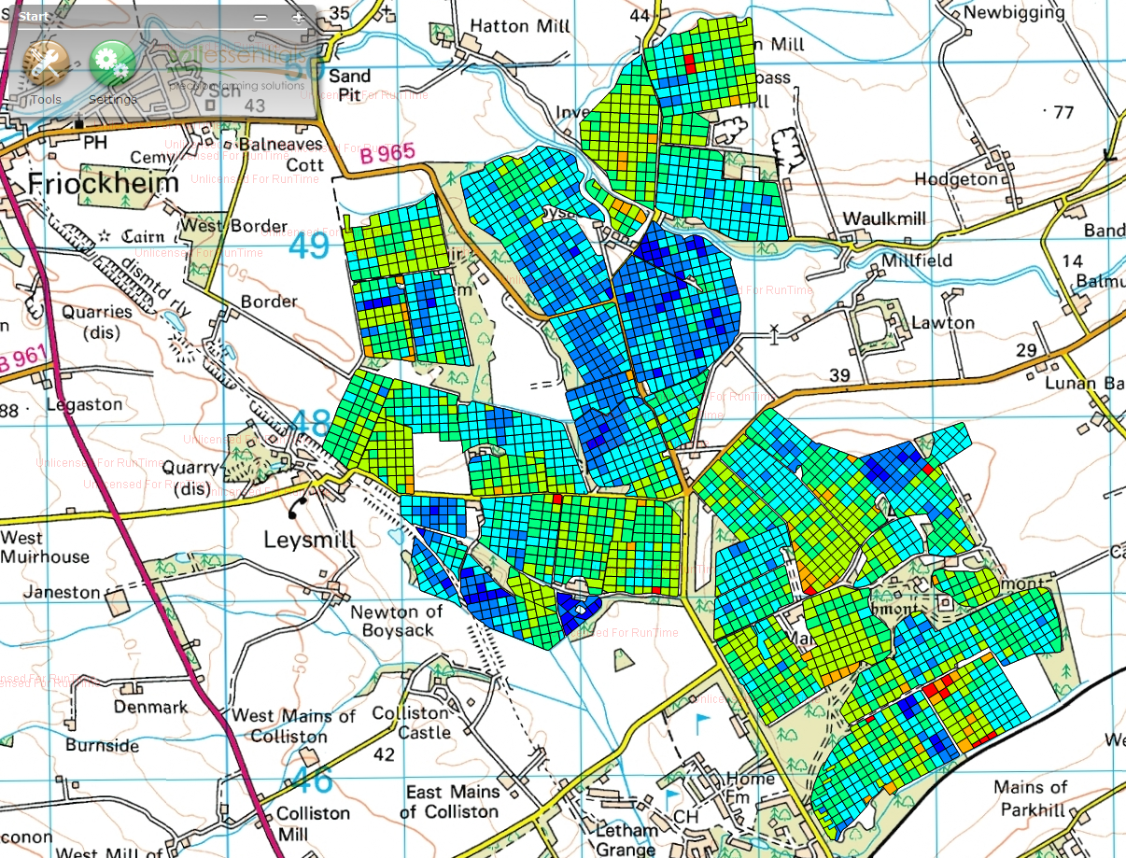
This Allows us to Create Shapefiles

Slide 23
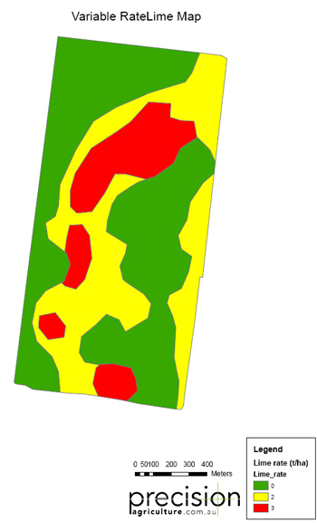
Variable Rate Lime Map

Slide 24
Is GPS That Accurate?

Slide 25


Slide 26

But Wait…

Slide 27
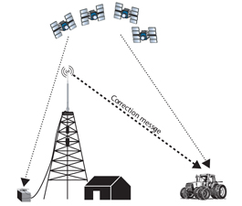
Real Time Kinematic (RTK)

Slide 28
Step 2 – Monitoring Growth Phase

Slide 29

This is Done by Machine Vision

Slide 30
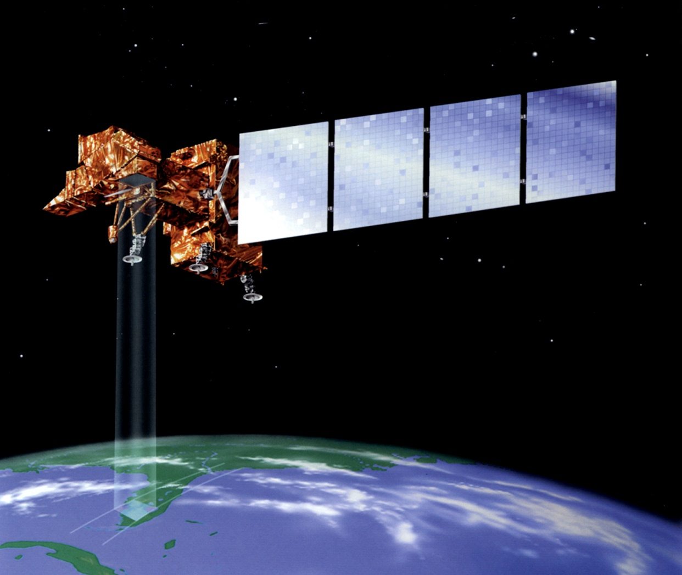
Satellite For NDVI

Slide 31
What’s NDVI?
Normalized Difference Vegetation Index
Plants strongly absorb visible light (0.4 – 0.7 um) (Green)
Plants strongly reflect light (0.7 – 1.1 um) (NIR)
NDVI = (NIR – VIS) / (NIR + VIS)
Range -1.0 to 1.0
-1.0 no vegetation
1.0 strong vegetation.

Slide 32
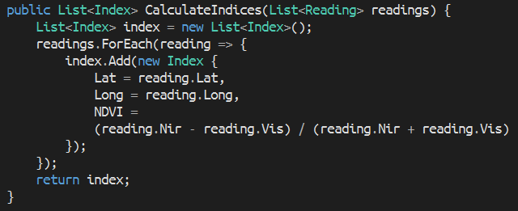
Calculation

Slide 33
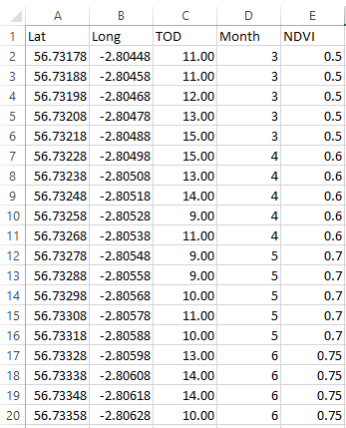
Regression

Slide 34
Log Linear Regression - Demo

Slide 35
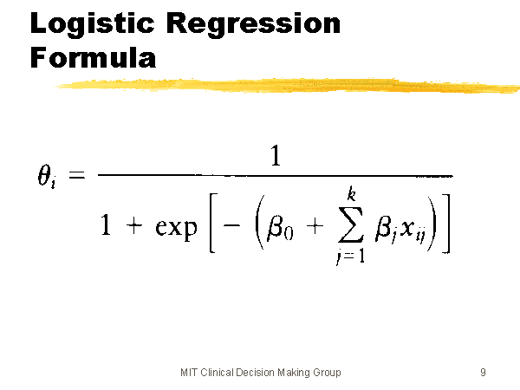
Prediction

Slide 36
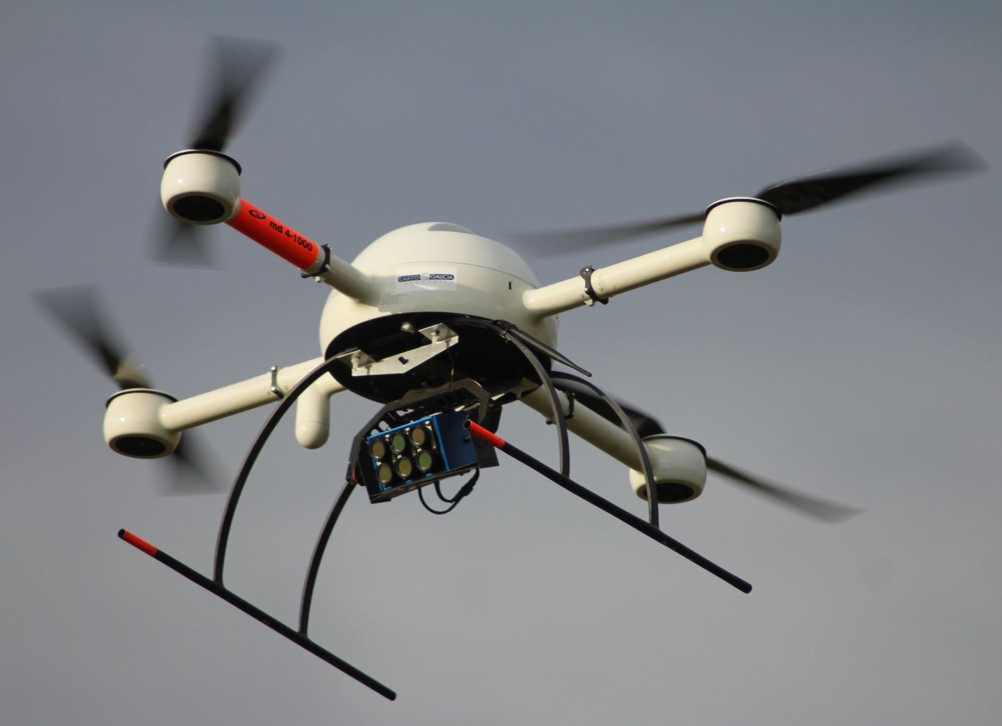
UAV For Crop Counting And Detection

Slide 37
Demo – Crop Counting / Weed Detection

Slide 38
Questions?
Gary Short
Duncodin Limited
Freelance data scientist
Big Data architect / engineer
www.duncodin.it
gary@duncodin.it
@garyshort
Image © @Blackmarble

